Slide 1
Entity Relationships in Signum Framework

Slide 2
Index
EmbeddedEntity (1:1)
Reference to an Entity | Lite (N:1)
Unique Reference to an Entity | Lite (1:1)
Reference to an Entity | Lite (1:N)
Entity in middle (N:M)
MList
MList<value> (1:N)
MList<EmbeddedEntity> (1:N)
MList<Entity | Lite> (N:M)
virtual MList<Entity> (1:N)

Slide 3
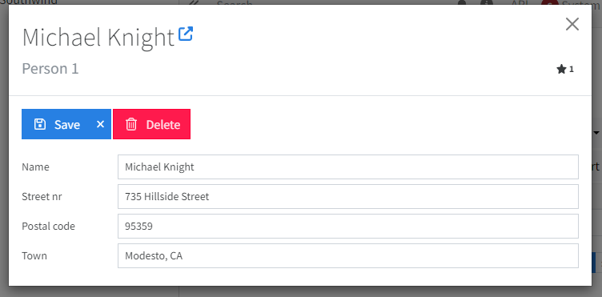
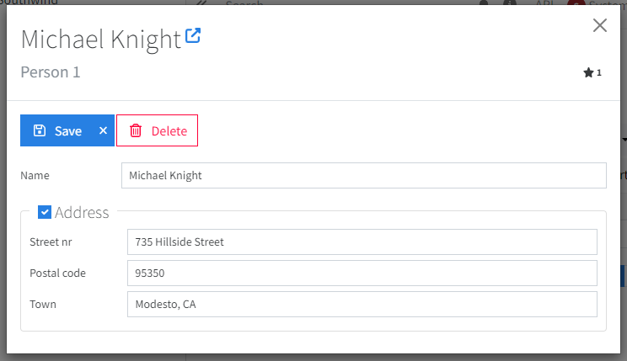
EmbeddedEntity (1:1)
<ValueLine ctx={ctx.subCtx(a => a.name)} />
<RenderEntity ctx={ctx.subCtx(a => a.address)} /> //Always there
<EntityDetail ctx={ctx.subCtx(a => a.address)} /> //Can be created and removed
[EntityKind(EntityKind.Main, EntityData.Master)]
public class PersonEntity : Entity
{
public string Name { get; set; }
public AddressEmbedded Address { get; set; }
}
dbo.Person
Id : INT
public AddressEmbedded? Address { get; set; }
Ticks: BIGINT
Name: NVARCHAR
Address_HasValue: Boolean
public class AddressEmbedded : EmbeddedEntity
{
public string StreetNr { get; set; }
public string PostalCode { get; set; }
public string Town { get; set; }
}
Address_StreetNr: NVARCHAR
Address_PostalCode: NVARCHAR
Address_Town: NVARCHAR

Slide 4
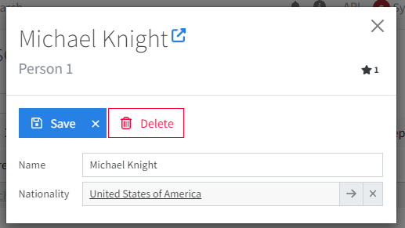
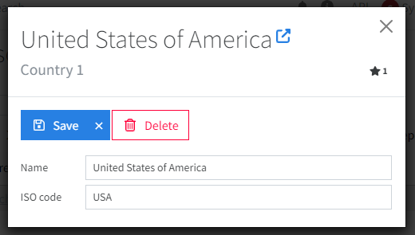
Reference to Entity | Lite (N :1)
//Person.tsx <EntityLine ctx={ctx.subCtx(a => a.nationality)} /> //Alternatives: EntityCombo
[EntityKind(EntityKind.Main, EntityData.Master)]
public class PersonEntity : Entity
{
public string Name { get; set; }
public CountryEntity? Nationality { get; set; }
}
[EntityKind(EntityKind.Shared, EntityData.Master)]
public class CountryEntity : Entity
{
public string Name { get; set; }
public string ISOCode { get; set; }
}
dbo.Person
dbo.Country
1
Id : INT
Id : INT
Ticks: BIGINT
Name: NVARCHAR
Name: NVARCHAR
N
ISOCode: NVARCHAR
CountryID: INT

Slide 5
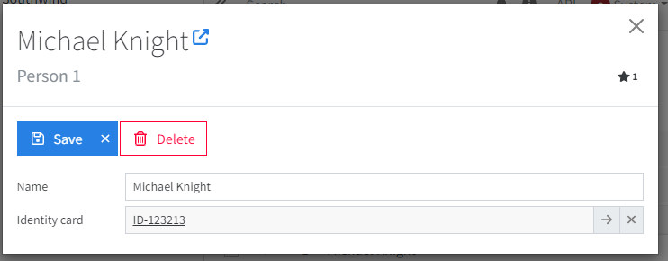
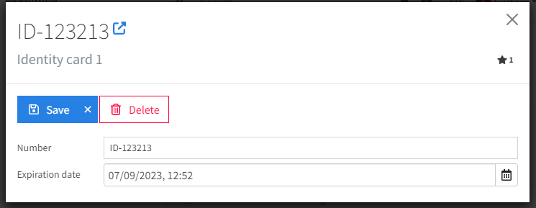
Reference to Entity | Lite with UniqueIndex (1:1)
//Person.tsx <EntityLine ctx={ctx.subCtx(a => a.identityCard)} find={false} autocomplete={null}/> //Alternatives: EntityDetail
[EntityKind(EntityKind.Main, EntityData.Master)]
public class PersonEntity : Entity
{
public string Name { get; set; }
[UniqueIndex]
public Lite<IdentityCardEntity> IdentityCard { get; set; }
}
[EntityKind(EntityKind.Shared, EntityData.Master)]
public class IdentityCardEntity : Entity
{
[UniqueIndex]
[StringLengthValidator(Max = 100)]
public string Number { get; set; }
public DateTime ExpirationDate { get; set; }
}
[UniqueIndex(AllowMultipleNulls = true)]
public Lite<IdentityCardEntity>? IdentityCard { get; set; }
dbo.Person
dbo.IdentityCard
Id : INT
1
Id : INT
Ticks: BIGINT
Number: NVARCHAR
Name: NVARCHAR
1 (UniqueIndex)
ExpirationDate: DATETIME2
IdentityCardID: INT

Slide 6
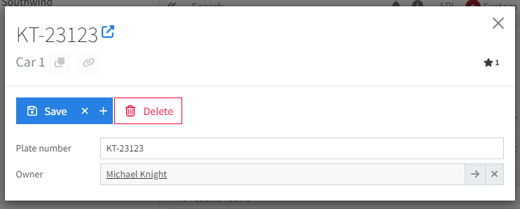
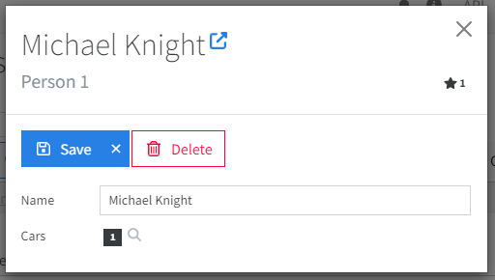
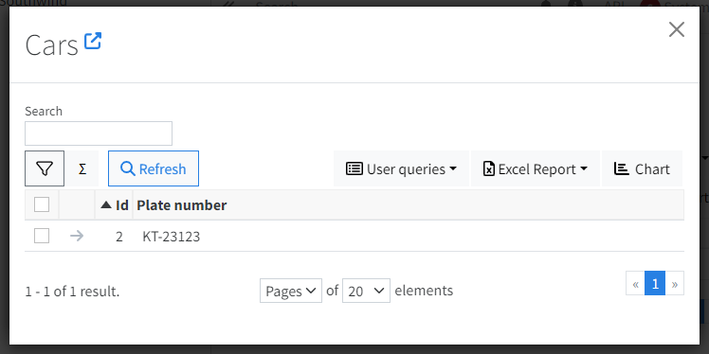
Reference to Entity | Lite (1:N)
<SearchValueLine ctx={ctx} findOptions={{
queryName: CarEntity,
filterOptions: [
{ token: CarEntity.token(a => a.owner), value: ctx.value }
]
}} /> //Alternatives: SearchControl, SearchValue
//Car.tsx <EntityLine ctx={ctx.subCtx(a => a.owner)} /> //Alternatives: EntityCombo
[EntityKind(EntityKind.Main, EntityData.Master)] public class CarEntity : Entity
{
public string PlateNumber { get; set; }
public Lite<PersonEntity> Owner { get; set; }
}
[EntityKind(EntityKind.Main, EntityData.Master)]
public class PersonEntity : Entity
{
public string Name { get; set; }
}
dbo.Car
dbo.Person
1
Id : INT
Id : INT
N
Name: NVARCHAR
Ticks: BIGINT
OwnerId: INT
Name: NVARCHAR

Slide 7
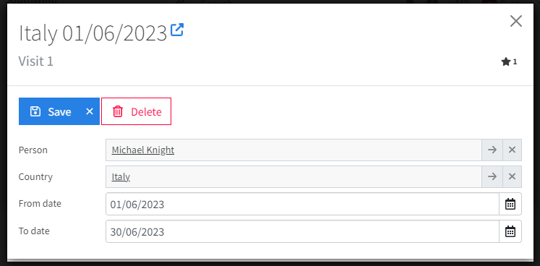
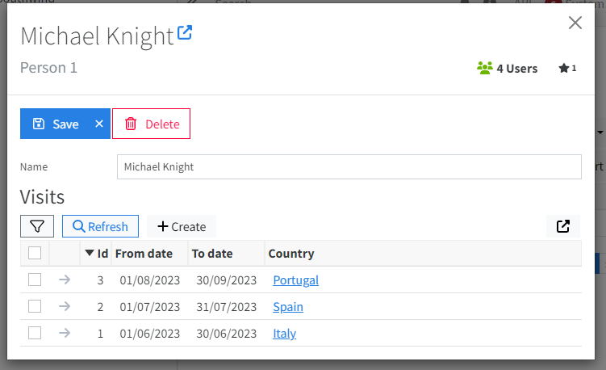
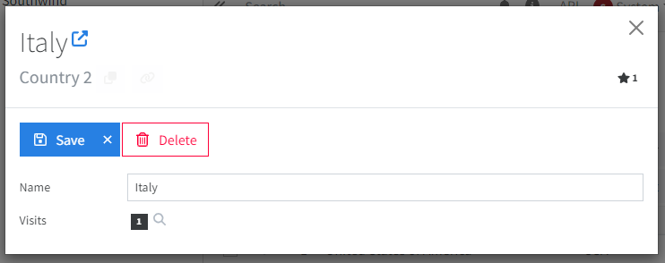
Entity in the Middle (N:M)
<h3>{VisitEntity.nicePluralName()}</h3>
<SearchControl ctx={ctx} findOptions={{
queryName: VisitEntity,
filterOptions: [
{ token: VisitEntity.token(a => a.person), value: ctx.value }
]
}} />
<SearchValueLine ctx={ctx} findOptions={{
queryName: VisitEntity,
filterOptions: [
{ token: VisitEntity.token(a => a.country), value: ctx.value }
]
}} />
[EntityKind(EntityKind.Main, EntityData.Transactional)]
public class VisitEntity : Entity
{
public Lite<PersonEntity> Person { get; set; }
public Lite<CountryEntity> Country { get; set; }
public DateOnly FromDate { get; set; }
public DateOnly ToDate { get; set; } }
[EntityKind(EntityKind.Shared, EntityData.Master)]
public class CountryEntity : Entity
{
public string Name { get; set; }
public string ISOCode { get; set; }
}
[EntityKind(EntityKind.Main, EntityData.Master)]
public class PersonEntity : Entity
{
public string Name { get; set; }
}
dbo.Visit
dbo.Person
Id : INT
dbo.Country
1
N
PersonId: INT
1
Id : INT
M
Id : INT
Ticks: BIGINT
CountryId: INT
FromDate: DATE
Name: NVARCHAR
Name: NVARCHAR
ISOCode: NVARCHAR
ToDate: DATE

Slide 8
MList<T>
A (small) collection of elements inside of an entity that will have his own table in the database

Slide 9
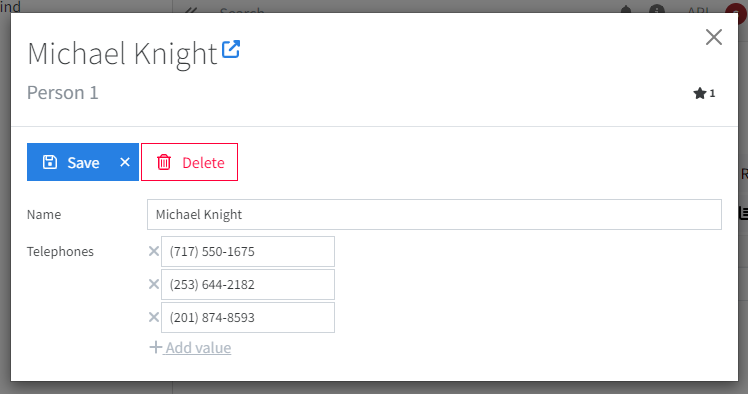
MList<string | int | DateTime | Enum…> (1:N)
<MultiValueLine ctx={ctx.subCtx(a => a.telephones)} /> //Alternative for enum: EnumCheckBoxList
[EntityKind(EntityKind.Main, EntityData.Master)] public class PersonEntity : Entity
{
public string Name { get; set; }
[PreserveOrder, NoRepeatValidator]
public MList<string> Telephones { get; set; } = new ();
}
dbo.PersonTelephones
dbo.Person
1
Small N
RowId : INT
Id : INT
ParentId: INT
Ticks: BIGINT
Order: INT
Name: NVARCHAR
Value: NVARCHAR

Slide 10
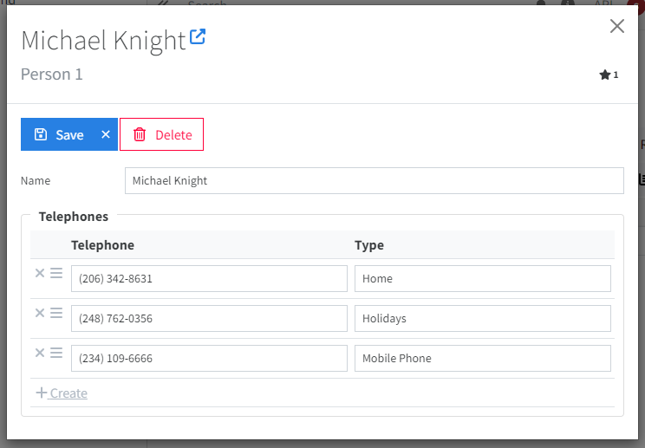
MList<EmbeddedEntity> (1:N)
<EntityTable ctx={ctx.subCtx(a => a.telephones)} /> //Alternatives: EntityRepeater, EntityTabRepeater, EntityAccordion
[EntityKind(EntityKind.String, EntityData.Master)]
public class PersonEntity : Entity
{
public string Name { get; set; }
[PreserveOrder, NoRepeatValidator]
public MList<TelephoneEmbedded> Telephones { get; set; } = new();
}
public class TelephoneEmbedded : EmbeddedEntity
{
[StringLengthValidator(Max = 100)]
public string Telephone { get; set; }
[StringLengthValidator(Max = 100)]
public string Type { get; set; }
}
dbo.PersonTelephones
dbo.Person
1
Small N
RowId : INT
Id : INT
ParentId: INT
Ticks: BIGINT
Order: INT
Name: NVARCHAR
Telephone: NVARCHAR
Type: NVARCHAR

Slide 11
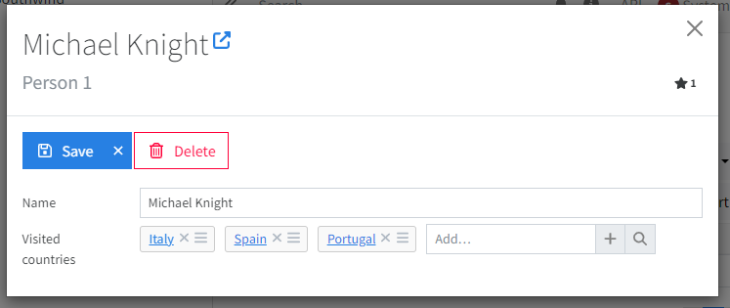
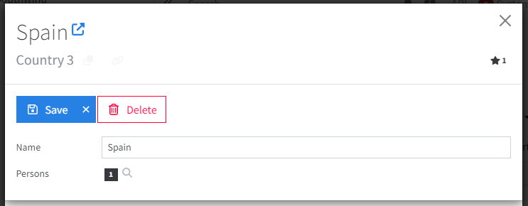
MList<Entity | Lite> (N:M)
<EntityStrip ctx={ctx.subCtx(a => a.skills)} /> //Alternatives: EntityCheckboxList
<SearchValueLine ctx={ctx} findOptions={{
queryName: PersonEntity,
filterOptions: [
{ token: PersonEntity.token(a => a.entity.visitedCountries).any(), value: ctx.value }
]
}} /> //Alternatives: SearchControl, SearchValue
[EntityKind(EntityKind.Main, EntityData.Master)]
public class PersonEntity : Entity
{
public string Name { get; set; }
[PreserveOrder, NoRepeatValidator]
public MList<CountryEntity> VisitedCountries { get; set; } = new();
}
[EntityKind(EntityKind.Shared, EntityData.Master)]
public class CountryEntity : Entity
{
public string Name { get; set; }
public string ISOCode { get; set; }
}
dbo.PersonVisitedCountries
dbo.Person
dbo.Country
1
Small N
RowId : INT
Id : INT
ParentId: INT
Big M
1
Id : INT
Ticks: BIGINT
CountryId: INT
Name: NVARCHAR
Name: NVARCHAR
ISOCode: NVARCHAR

Slide 12
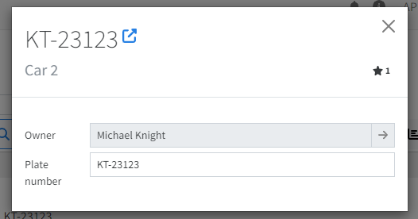
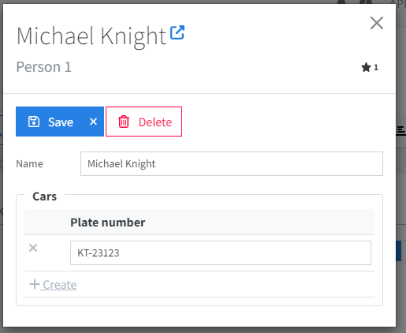
Virtual MList<Entity> (1:N)
<EntityTable ctx={ctx.subCtx(p => p.cars)} columns={EntityTable.typedColumns<CarEntity>([
//{ property: p => p.owner }, automatic
{ property: p => p.plateNumber },
])} />
<EntityLine ctx={ctx.subCtx(a => a.owner)} readOnly />
But is a real Entity that can contains his own MList<WheelEntity> or be referenced by AccidentEntiy
Cars looks like an MList<EmbeddedEntity>
//in PersonLogic.cs
sb.Include<PersonEntity>()
.WithVirtualMList((PersonEntity p) => p.Cars, a => a.Owner)
[EntityKind(EntityKind.Part, EntityData.Master)]
public class CarEntity : Entity
{
[NotNullValidator(Disabled = true)]
public Lite<PersonEntity> Owner { get; set; }
public string PlateNumber { get; set; }
}
[EntityKind(EntityKind.Main, EntityData.Master)]
public class PersonEntity : Entity
{
public string Name { get; set; }
[Ignore, QueryableProperty] //virtual MList
public MList<CarEntity> Cars { get; set; } = new();
}
dbo.PersonCars
RowId : INT
ParentId: INT
SkillId: INT
dbo.Car
dbo.Person
Id : INT
Id : INT
OwnerId: INT
Ticks: BIGINT
1
Small N
PlateNumber: NVARCHAR
Name: NVARCHAR

Slide 13
Conclusions
An Entity class has his own table.
An MList<T> property has his own table.
An EmbeddedEntity class groups some properties together and lives inside an Entity table or a MList table.
With the virtual MList pattern we show a list in the UI as if it was an MList<EmbeddedEntity> (1:N) but be able to reference the elements because are real Entity. An MList<Entity> would create a N:M relationship.

